Slide 1
Unit 7 website planning
By adam azzam

Slide 2
Site map navigation layout
Home page
photos
videos
more
contact

Slide 3
What will my website feature
Within my website it will all be based around my instagram page @addzmotion which I use as a platform to make my portfolio for all my videography and photography work, so for my website ill be posting some of my videos on there.
The addition of hashtags can also readily make the page visible, as spectators may like to discover some phrases for their own purposes.
The photographs on which the images I took and which I have interest are the basis of my SEO considers. My page may contain certain keywords to create it fun to view by spectators.
What I will post there:
Photos
Videos
About me

Slide 4
Back up plan
For my back up plan in case everything doesn't work out I will make a website about my footballing story where in will include past teams I have played for and other footballing opportunities I have had for professional clubs.

Slide 5
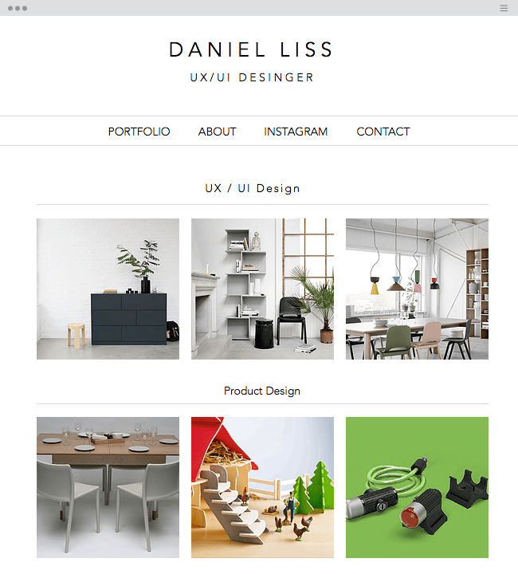
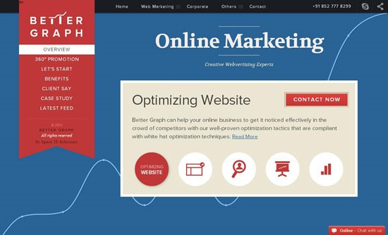
Mock designs

Slide 6
Colour schemes
My website will not have any specific color schemes as it will mainly be showing my photos and videos, however in the background i will include the colour white and grey in the background

Slide 7
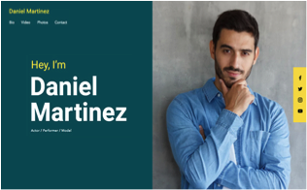
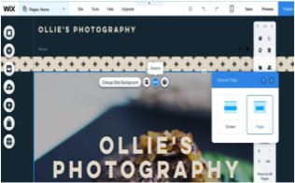
Layout ideas

